Slide 1
Lecture 32
Plasmonics

Slide 2
Metal properties
Metal conductivity
Metal dielectric constant
50
20
0
-50
15
ε_{r}
ε_{i}
-100
10
-150
5
-200
0.2
0.4
0.6
0.8
1
1.2
1.4
1.6
1.8
2
0
Wavelength (μm)
0.2
0.4
0.6
0.8
1
1.2
1.4
1.6
1.8
2
Wavelength (μm)
Plasma frequency
Metal Plasma Frequencies and Scattering Rates
Plasma frequency
Scattering rate
gold Au 2081 THz 8.5 eV 12.3×10¹³ s⁻¹
silver Ag 2182 THz 9.0 eV 3.2 ×10¹³ s⁻¹
aluminum Al 3231 THz 13.2 eV 27.3×10¹³ s⁻¹

Slide 3
Permittivity of gold

Slide 4
Bulk Plasmons
Re-write dielectric constant
Screened plasma frequency
Neglect damping
Maxwell equation:
Transverse wave
Another solution: Longitudinal wave
Magnetic field is zero!
We can also write
Charge oscillations wave
Shifted by 90 degrees in phase
Electron density wave
Current density
Continuity equation
Works for any k!!!
E
Dispersion of bulk plasmons
z
ω
+
ω_{ps}
No energy flow
+
-
+
-
-
+
ρ
Goes to very large k’s –beyond diffraction limit
“quasi-static wave”
z
k

Slide 5
Origin of bulk plasmons
What if there is no external field, and we just move all the carriers by Δz?
Δz
Q_{s} Surface Charge
S-area
+
+
+
+
+
+
+
+
+
+
+
+
-
-
-
-
-
-
-
-
-
-
-
-
Induced field
Force acting on each electron
F_{s}
Equation of motion
Self-sustaining longitudinal oscillations
E_{s}
Induced field
Metal
Free Electrons

Slide 6
Surface plasmon
metal
+
+
+
+
+
+
+
+
+
+
+
+
+
+
+
+
+
+
-
-
-
-
-
-
-
-
-
-
-
-
-
-
-
-
-
-
+
+
+
+
+
+
+
+
+
+
+
+
+
+
+
+
+
+
-
-
-
-
-
-
-
-
-
-
-
-
-
-
-
-
-
-
ε_{m}<0
Self-sustaining surface charge oscillations
ε_{d}>0
dielectric
Reduction of resonance frequency is due to fringing of the field – only one half of the field actually contributes to the tangential restoring force acting upon the electrons

Slide 7
Surface plasmon polaritons (SPP)
Surface plasmons are not pure longitudinal waves …hence they can couple with transverse electromagnetic waves – photons
ε_{m}<0
x
metal
H_{y} E_{z}
z
Maxwell equations
β
ε_{d}>0
dielectric
SPP is a TM wave propagating along the interface and evanescent in both mediums, with an interesting dispersion
E
H

Slide 8
Surface plasmon polaritons (SPP)
E
Inside the metal
H
In the dielectric
Subtract
Longitudinal electric field
Boundary condition –continuous E_{z}
Effective index
When

Slide 9
SPP dispersion
Surface plasmon resonance frequency
ε_{m}<0
metal
If the dielectric is vacuum and also then
For
Light is mostly in the dielectric
|E|²
For
ε_{d}>0
dielectric
50% of light is in the metal
ε_{m}<0
metal
“plasmon -like”
|E|²
ε_{d}>0
dielectric
“photon -like”

Slide 10
SPP characteristics
Spatial confinement
Normal wave
Sub-wavelength confinement
Slow wave
Group velocity
For

Slide 11
Why SPP is a slow wave?
ε_{m}<0
metal
x
z
β
y
Pointing vectors in the dielectric and metal point in the opposite directions
ε_{d}>0
dielectric
Power is
Near the SP resonance !!!
One half of the energy is in the metal and the other half is in dielectric – as they propagate in the opposite directions there is no net motion of energy
Naturally, the effective rate of the energy decay for the SP mode approaches half of the energy decay rate i.e. γ

Slide 12
More SPP characteristics
“polarization” is “elliptical” as x and z components are shifted by 90 degrees.
ε_{m}<0
metal
Longitudinal
(plasmon)
ε_{d}>0
dielectric
Elliptical(polariton)
In metal
In dielectric
Transverse
(photon)

Slide 13
Effective impedance of SPP
ε_{m}<0
metal
|E|²
ε_{d}>0
dielectric
Total electric field in the dielectric
Effective impedance increases with β
For
Large impedance means difficulty in coupling
Total electric field in the metal
η_{SPP}
η‘_{SPP}
Smaller effective impedance

Slide 14
Energy of the SPP
Magnetic energy (per unit area) in the dielectric
Magnetic energy (per unit area) in the metal
ε_{m}<0
metal
|E|²
ε_{d}>0
dielectric
Electric energy (per unit area) in the dielectric
Electric energy (per unit area) in the metal
Normalize to
In Dielectric
In Metal
Electric
Electric
Magnetic
Magnetic

Slide 15
Potential and Kinetic Energies
Kinetic energy density:
Kinetic energy
Oscillates as sin²ωt
Electric (potential) energy
Oscillates as cos²ωt
Total out of phase (quadrature)energy oscillating as sin²ωt
In phase electric energy oscillating as cos²ωt
Magnetic energy oscillating as sin²ωt
Perfect Balance!
In phase electric
In phase electric
Kinetic
Magnetic
Photon-like
Plasmon-like
Photon-like
Plasmon-like
Magnetic
Kinetic

Slide 16
Damping and Propagation Length of SPP
Approximately
Power flow
Propagation length
Close to SP resonance
Imaginary β
Real β for γ=0
Maximum β
ω/ω_{sp}
Real β
Typically in the visible
Gold/Air
Silver/Air
(silver oxidizes easily)
β in units of n_{d}ω_{sp} /c

Slide 17
Damping and propagation length
0.1
0.05
γ/ω_{sp}=0.15
γ/ω_{sp}=0
The maximum wavevector is limited by the damping
ω/ω_{sp}
Figure of merit
β in units of n_{d}ω_{sp} /c
Ag
Au
Ag
Au
n_{eff}
n_{eff}

Slide 18
SPP excitation
Kretschmann configuration
k₀n_{d}
n₂ >n_{d}
k₀n_{d}
β_{spp}
k₀n₂sinθ
k₀n₂sinθ
θ
k₀n₂
n_{d}
z
ATR (attenuated total reflection)
Resonance condition
Also works as a sensor

Slide 19
Plasmonic sensing
n₂ >n_{d}
θ
Index change
n_{d}
+δn
1
1
n₂
n_{m}
n_{d}
0.8
0.8
y
d
t
l
i
e
v
i
i
0.6
F
0.6
t
c
c
i
e
r
l
t
f
c
e
0.4
e
0.4
R
l
E
0.2
0.2
δθ
0
0
20
40
60
80
0
-200
-100
0
100
200
300
Angle (deg)
Distance (nm)

Slide 20
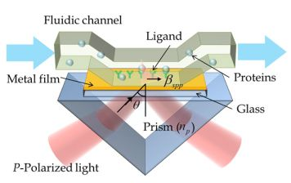
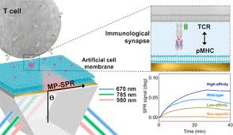
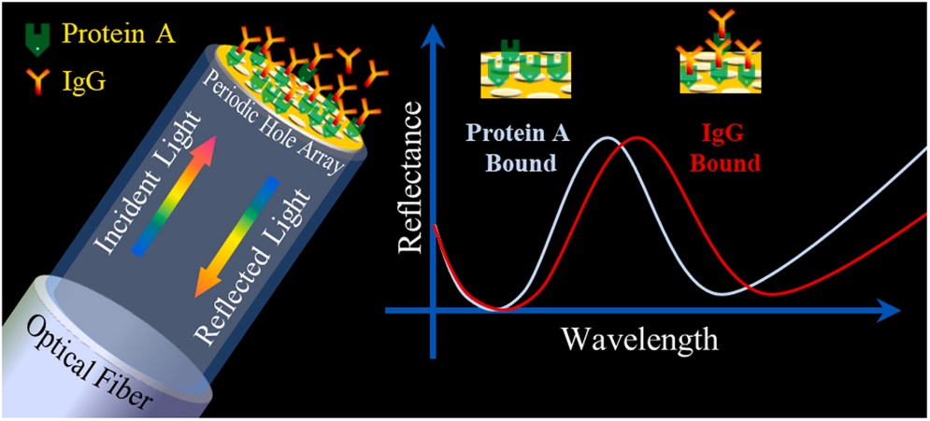
Plasmonic sensors

Slide 21
SPP excitation

Slide 22
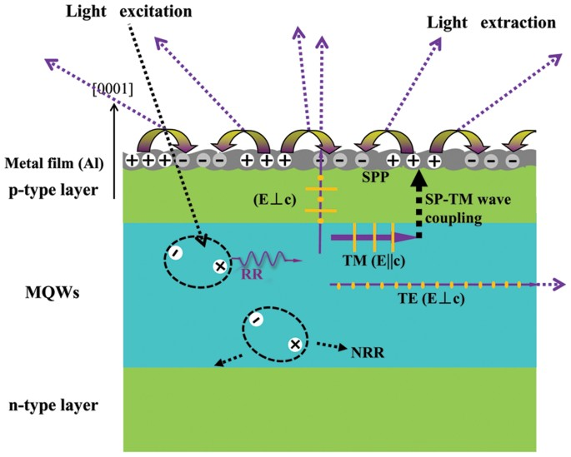
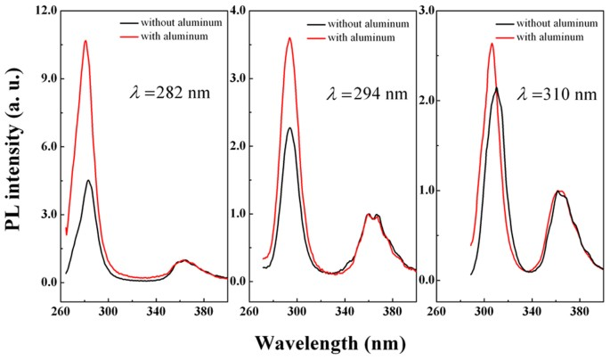
SPP enhanced LED

